Slide 1
A project presentation on Kernel Re-Implementation
By:
Vikram Tiwari (0901010118)
Shivam Gupta (0901013080)
Tanishka Chaturvedi (0901044061)
Submitted To:
Mr. Sanjay Pandey (Head of Department, CS, UCER)

Slide 2
Project Details
Project Name: Kernel Re-Implementation
Project Description: To write a minimal Linux based kernel from the scratch, while using minimal libraries and functional assists from the current Linux kernel.
Project Dependencies: Linux Kernel v2.6, GNU tools, GPL v3 license, GRUB boot loader and GTK GUI.
Project Mentor: Mr. Sanjay Pandey (HOD, CS Dept.)
Project Team:
Vikram Tiwari: Team Leader and Platform maintainer
Shivam Gupta: Device and Algorithms maintainer
Tanishka Chaturvedi: Bug Reporting maintainer

Slide 3
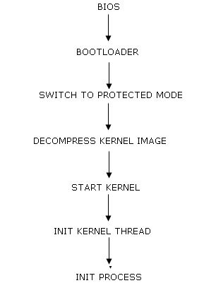
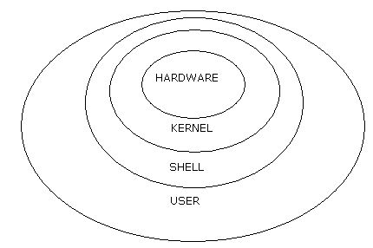
What is Kernel?

Slide 4
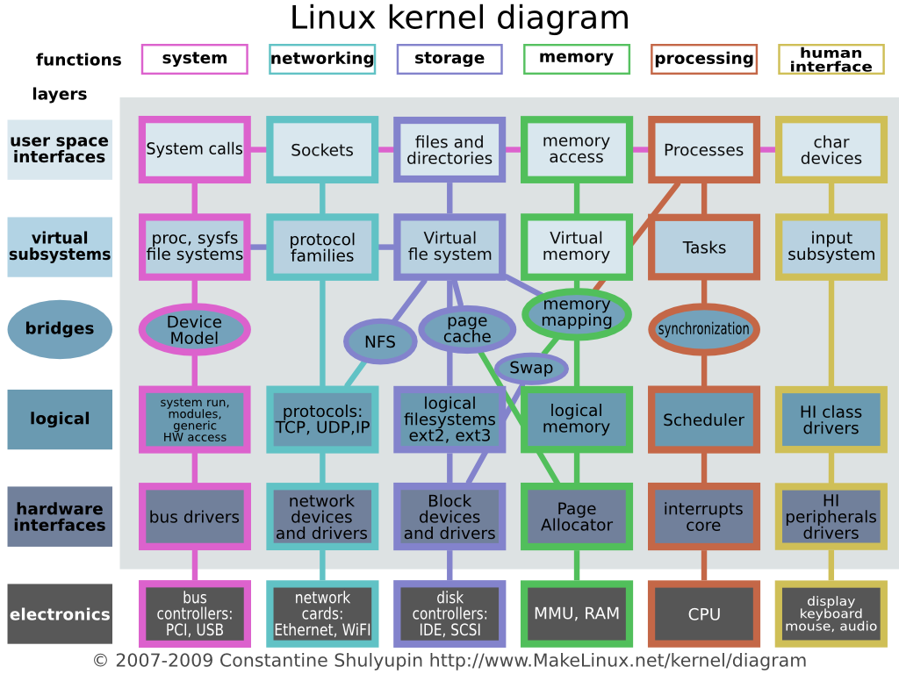
A more detailed description

Slide 5
How the kernel is developed?
Hardware Interfaces
Logical Interfaces
Bridges
Virtual File System
User Mode

Slide 6
Hardware Interfaces
A Bare System
Contains POST program
No Operating System
No OS Found Error
Requires Boot loader
Boot Code
Monitor Interfaces

Slide 7
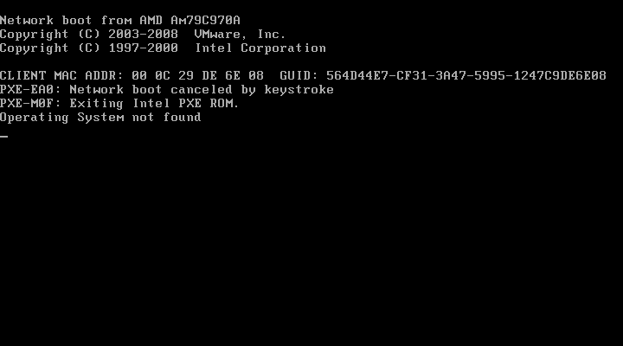
Hardware Interfaces

Slide 8
Logical Interfaces
System Abstraction
Memory Level Abstraction
Interrupt Interfaces
Global Descriptor Table
Interrupt Descriptor Table

Slide 9
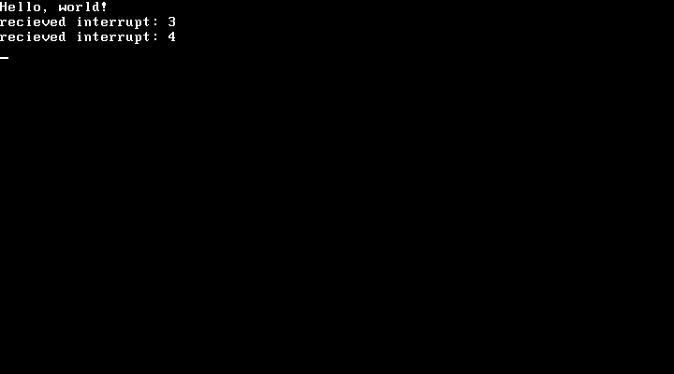
Logical Interfaces

Slide 10
Bridges
Request Queues
Programmable Interval Timer
Virtual Memory
Page faults

Slide 11
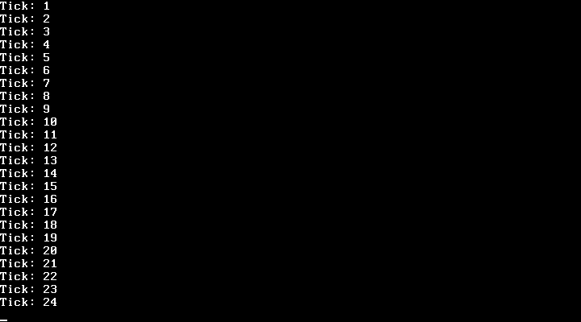
Bridges

Slide 12
Virtual File System

Slide 13
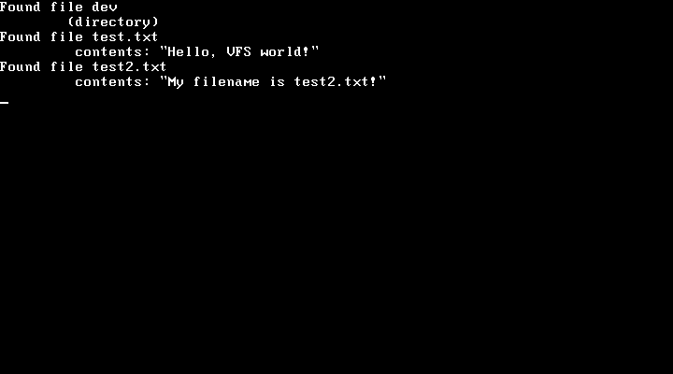
Virtual File System

Slide 14
User Mode

Slide 15
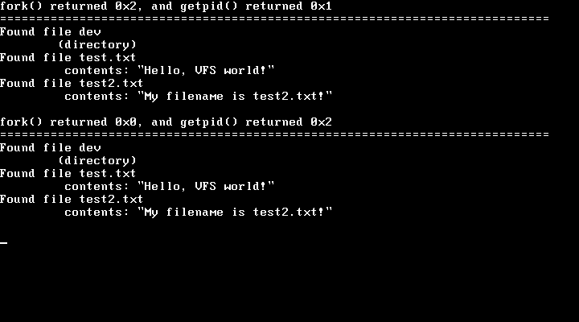
User Mode

Slide 16
Usability

Slide 17
Queries

Slide 18
Thanks!

